Slide 1
Intro to Web Dev: Final Project Proposal
Jacob Jiang

Slide 2
Overview:
Adaptive Soundscape
Synthesize and play audio to mimic natural environments
Based on live weather and time

Slide 3
To-Do:
Use Web Audio API to create sounds for wind, rain, etc.
Make API calls to fetch weather and location
Link HTML elements to JS logic (audio playback)
Dynamic theme and colors based on time of day

Slide 4
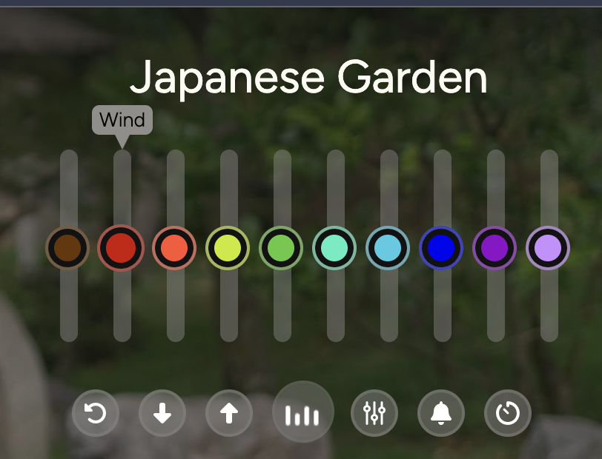
Inspiration:
Volume Dials
Set Default State
Customizable
https://mynoise.net/NoiseMachines/japaneseGardenSoundscapeGenerator.php

Slide 5
Intro to Web Dev: Final Project Proposal
Jacob Jiang

